Slide 1
Evaluations:
pros and cons of
Wizard design vs. Sorting design vs. Flow design
Participants: Allen, Molly, Justin, Jessica, Tal, Jeremie, Jaoyi
2017/02/16

Slide 2
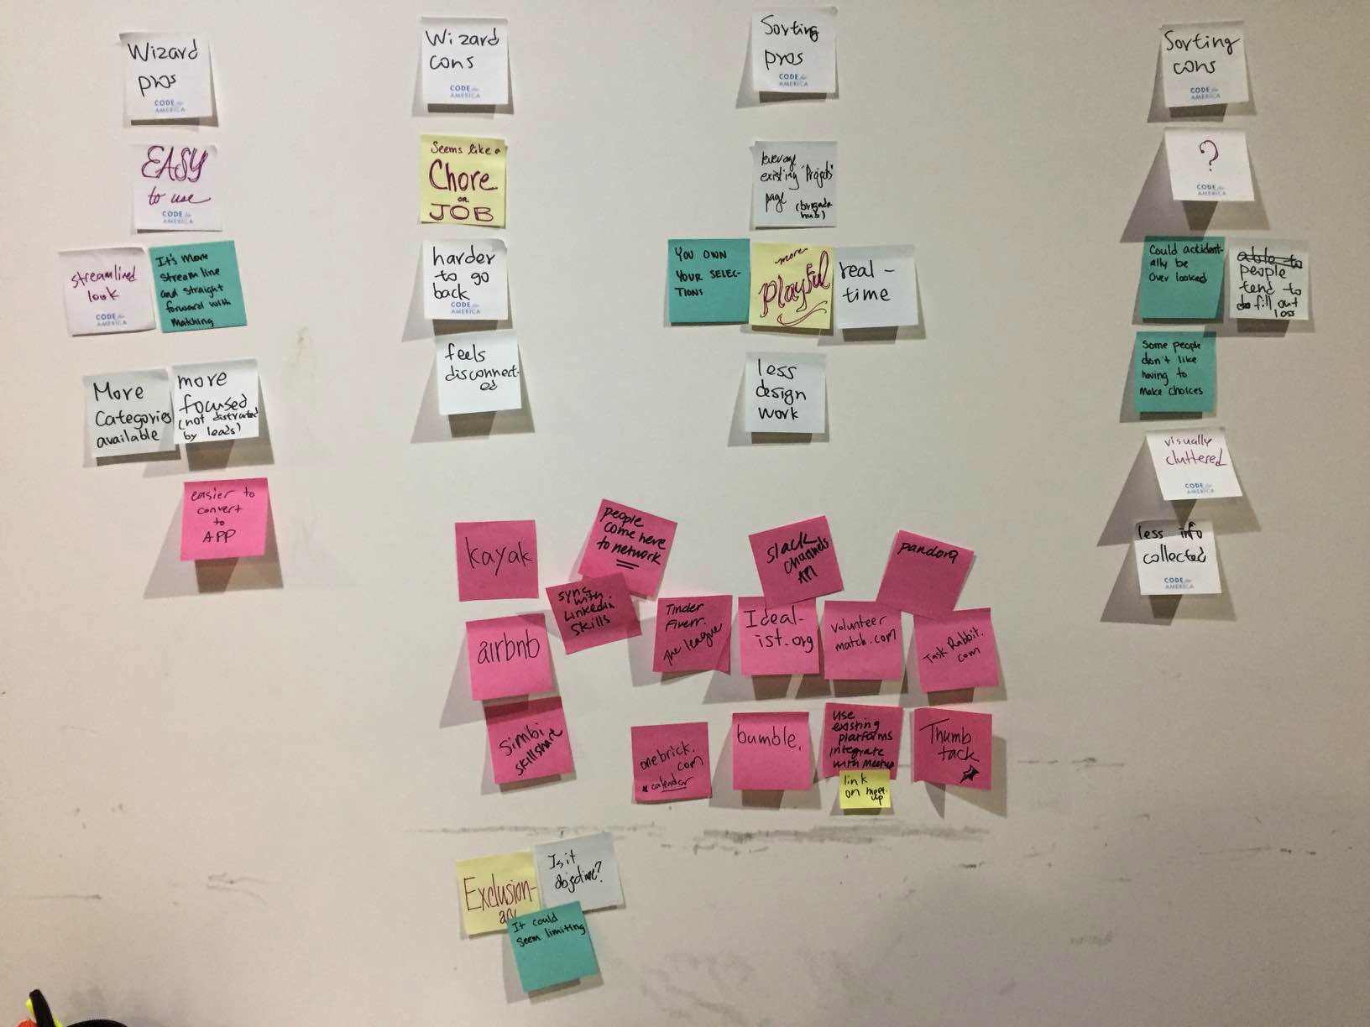
Wizard Pros
Streamlined, straightfoward
More focused. Possibly collect more info from users before distracted.
Easier to convert to Apps
Wizard Cons
Seems like chore/work
Harder to manipulate
Feels disconnected from project l ist
Notes:
(Photo credit: James) Wizard design is the original design. Users go through four steps to fill out a basic portfolio -> receive a list of projects with the best matches on top -> contact teams.

Slide 3
Sorting on top- Pros
Leverage Brigadehub’s current design
More user control
More playful
More real-time
Less design work
Sorting on top- Cons
Could get overlooked
Users get distracted
Feels like extra choices to make
Could be visually more cluttered
Notes:
(Photo credit: James) Sorting design resembles many real estate sites and travel sites. Users manipulate the filtering criterias on top, and the list below reflects the matches. We decided to use ‘sorting’ instead of ‘filtering’ so that all project teams show up.

Slide 4
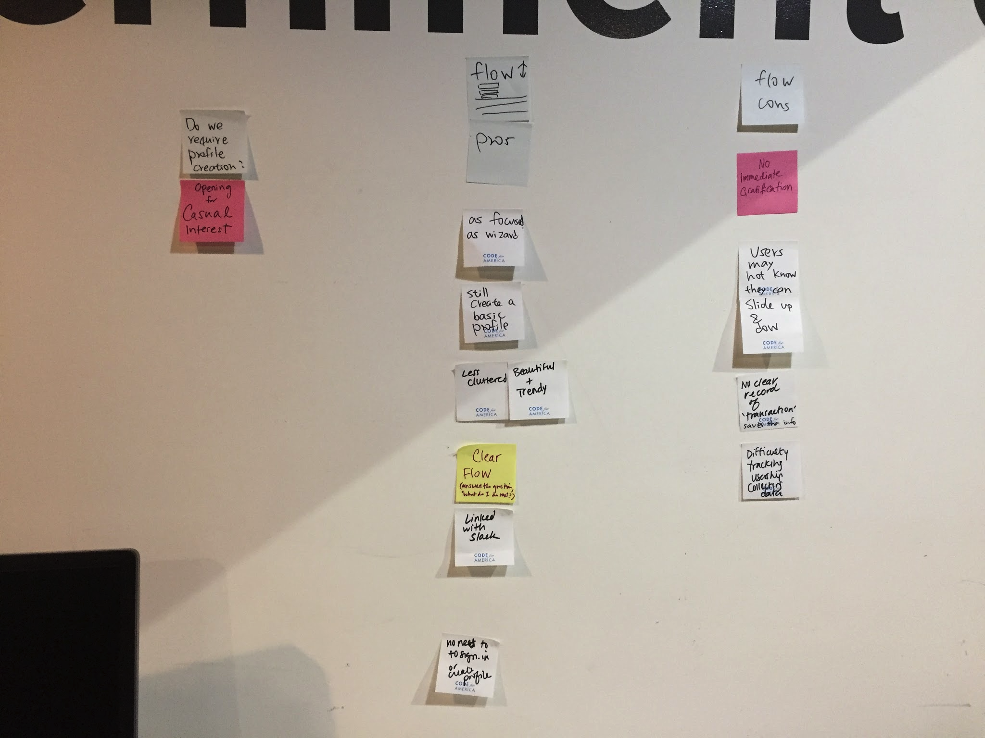
Flow Pros
As focused as wizard
Basic profile is created
Trendy
Less cluttered
Clear flow
Slack integration
Flow Cons
No immediate gratification
Have to slide up and down
No record saved for new members
No recrod saved for project team leads
Notes:
(Photo credit: James) Flow design is proposed by Tal. The top page allows users to fill in the sorting criteria. Once they slide down, a list of project teams show up with the best matches on top. Users can slide back up to change the sorting criteria.

Slide 5
Inspirations
Other Notes
Connected to LinkedIn
Created a link to project matching on Meetup.com
Slack API
Craigslist
Kayak
Airbnb, Redfin/Zillow
Simbi, skillshare
Pandora
Tinder, Fiverr, The League, bumble
Onebrick.com (Calendar)
Idealist.org
Volunteer, Match.com
Task rabbit
Thum tack

